Slide 1
Corona Virus Analysis
By: Aryan Raghuwanshi
Batch Name: MIP-DA-09

Slide 2
What is this project?
This project is designed to test your SQL and data analysis skills in a real-world context. The coronavirus pandemic has significantly impacted public health and has created an urgent need for data-driven insights to understand the spread of the virus.

Slide 3
Columns of the dataset
Province: Geographic subdivision within a country/region.
Country/Region: Geographic entity where data is recorded.
Latitude: North-south position on Earth's surface.
Longitude: East-west position on Earth's surface.
Date: Recorded date of CORONA VIRUS data.
Confirmed: Number of diagnosed CORONA VIRUS cases.
Deaths: Number of CORONA VIRUS related deaths.
Recovered: Number of recovered CORONA VIRUS cases.

Slide 4
Discussion and Codes
To effectively tackle these SQL questions, start by mastering fundamental concepts such as checking for NULL values using the IS NULL condition and updating them with zeros using the UPDATE statement. Understand how to count total rows with the COUNT function and extract start and end dates from datasets. Utilize date functions to determine the number of months in the dataset. Learn to find monthly averages, most frequent values each month, and minimum and maximum values per year using GROUP BY and appropriate aggregate functions.

Slide 5
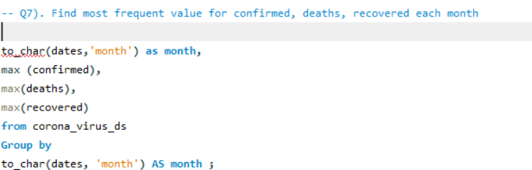

Slide 6
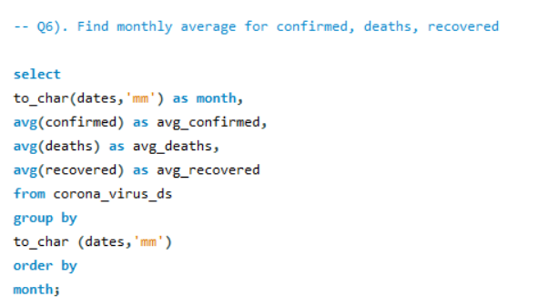

Slide 7
Conclusion
This project has provided students with hands-on experience in utilizing SQL for real-world data analysis, focusing on a COVID-19 dataset. They have learned to clean data, apply SQL functions effectively, and derive insights into the pandemic's spread and impact.

